Slide 1
Memory and Storage

Slide 2
Overview
Classification with Storage Medium
Classification with Access Method
  Principle
  RAM
  ROM
Classification with Computer Organization

Slide 3
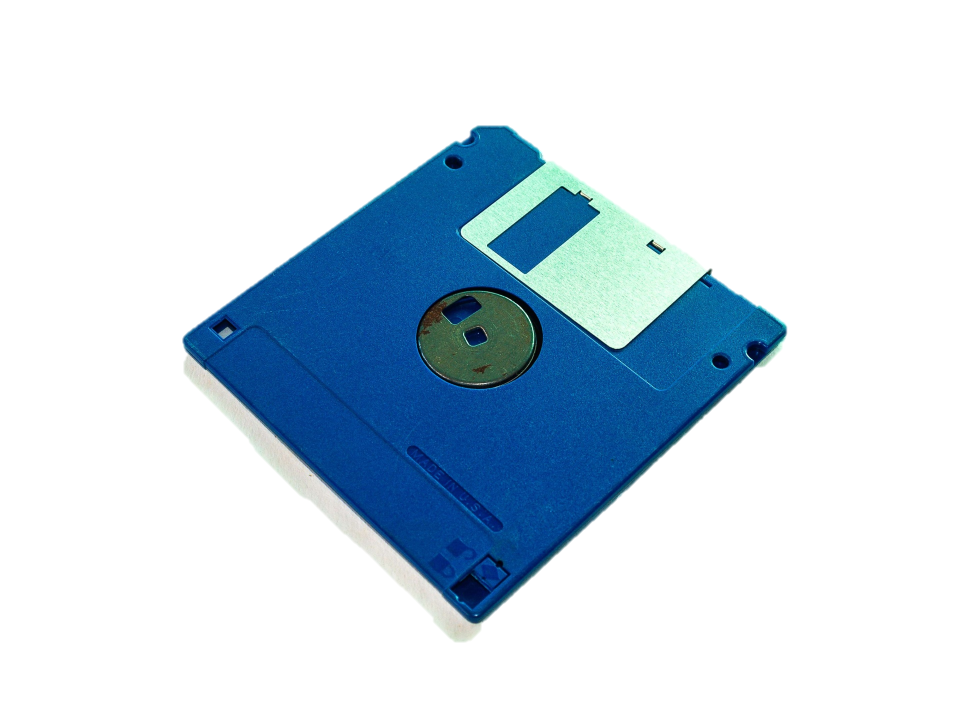

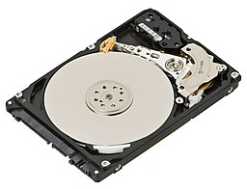
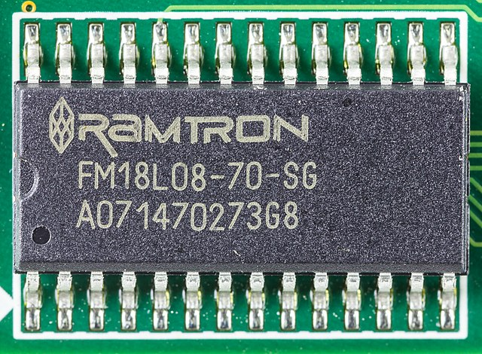
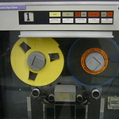
Storage Medium
Semiconductor
Magnetic
Optical
Volatile: SRAM, DRAM
Non-Volatile: EPROM, EEPROM, FlashMem.
Magnetic Disk
Magnetic Tapes
Optical Disc

Slide 4
What is Storage Medium
Storage medium is a device that stores, receives, and deletes data of the programs, like video disks, USB Flash disk.
Semiconductor, TTL(Transistor Logic), MOS(Metal Oxide Semiconductor)
Storage Medium
Magnetic Media
Optical Storage Device

Slide 5
Storage Medium
Semiconductor
Magnetic
Optical
Volatile: SRAM, DRAM
Non-Volatile: EPROM, EEPROM, FlashMem.
Magnetic Disk
Magnetic Tapes
Optical Disc

Slide 6
Access Method
Random Access
Sequential Access
Direct Access
RAM ROM
Magnetic Tapes
Magnetic Disks

Slide 7
What is Access Method
Access method defines how the data are read or written into storage medium, and it depends on the type of storage medium.
Sequential Access
Access Method
Direct Access
Random Access

Slide 8
Access Method
Random Access
Sequential Access
Direct Access
RAM ROM
Magnetic Tapes
Magnetic Disks

Slide 9
Sequential Access
Tape Head
Advantages:
Highest Capacity and cheapest
Disadvantages:
slowest (50-60 seconds)
Very unfriendly to random access

Slide 10
Access Method
Random Access
Sequential Access
Direct Access
RAM ROM
Magnetic Tapes
Magnetic Disks

Slide 11








Direct Access
Advantages:
Higher Capacity and cheaper
Faster than tapes
Disadvantages:
Slower than Random Access Devices( millisecond level)
Unfriendly to random address access
File system fragmentation
Sector
4 Tracks
Head moves to the specific track and then search the specific sector to find the data

Slide 12
Access Method
Random Access
Sequential Access
Direct Access
RAM ROM
Magnetic Tapes
Magnetic Disks

Slide 13
Random Access
CPU Data Address Decoder
Advantages:
Fastest (Nanosecond level)
Friendly to random access
Disadvantages:
Expensive
Hard to integrate
CPU Data Address Decoder
Data Interface

Slide 14
Random Access-RAM
RAM(Random Access Memory)
Volatile(Lost data when power off)
Store data temporarily
 | RAM
 | SRAM(Static RAM) | DRAM(Dynamic RAM)
Refresh | No | Yes
Complexity | High | Low
Integration | Low | High
Capacity | Low | High
Access Speed | High | Low
Power Consumption | High | Low
Price | High | Low
Application | Cache | Main Memory

Slide 15
Random Access-ROM
ROM(Read-Only Memory)
Non-Volatile(Still have data when power off)
Store some timeproof data, e.g. O.S. or part of O.S.
 | ROM
 | MROM | PROM | EPROM | FlashMem | EEPROM
 | Mask ROM | Progra-mmable ROM | Erasable PROM | Flash EEPROM Memory | Electrically EPROM
Erasable | No | No | Yes | Yes | Yes
Erasable Method |  |  | UV | Electric Field | Electric Field
Writeable | 1 | 1 | Many times | Many times | Many times
Price | Very low | low | Medium | High | Very high

Slide 16
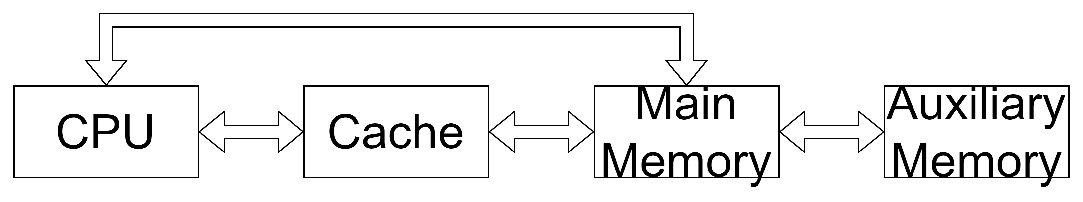
Computer Organization
3ns
50ns
5ms
SSD
(Solid-State Drive)
SRAM
(Static RAM)
RAM
ROM
Flash Memory
Disks(cheaper)
HDD
(Hard Disk Drive)

Slide 17
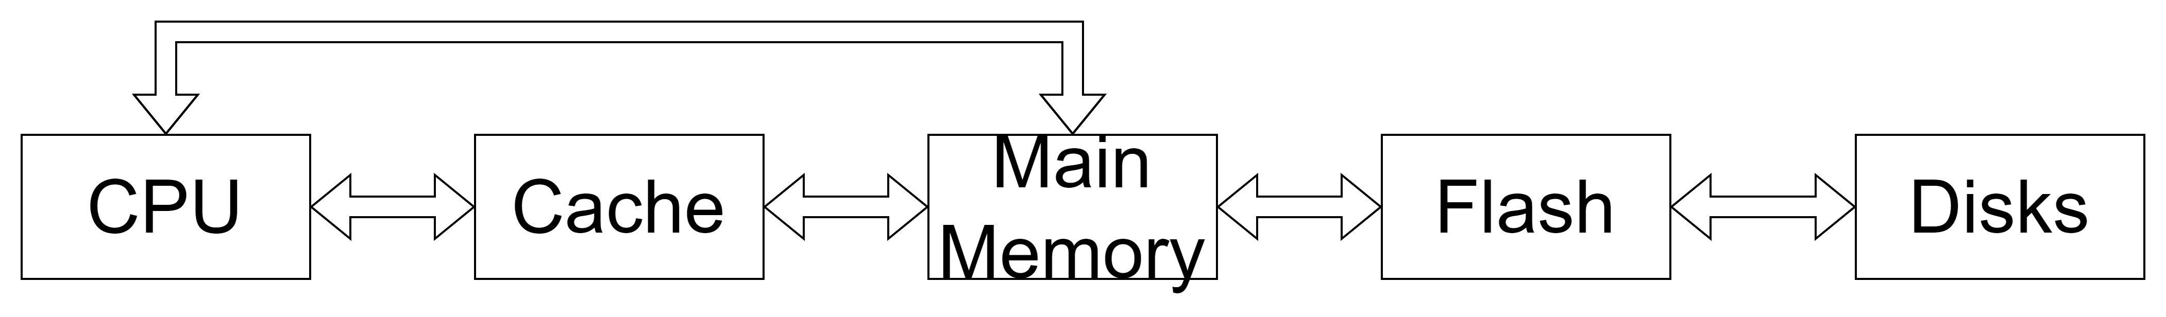
Computer Organization
SDD
HDD

Slide 18
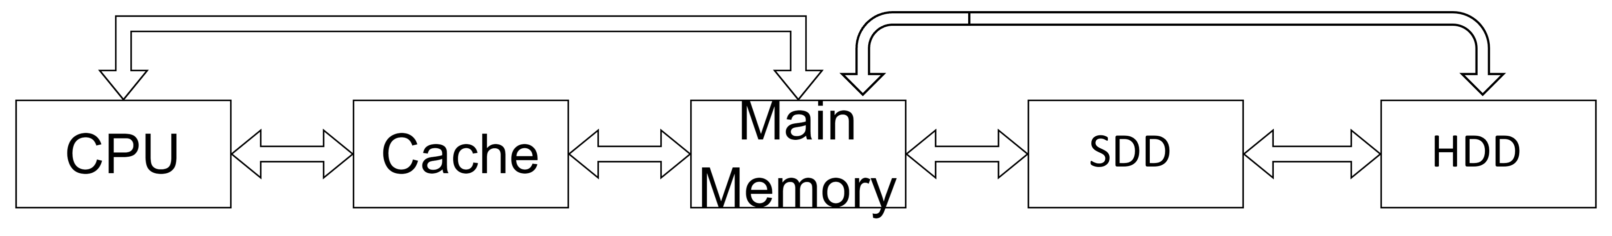
Computer Organization
Cache
MainMem
Access
Speed
Price
Capacity
SDD(Flash)
HDD(Disk)

Slide 19
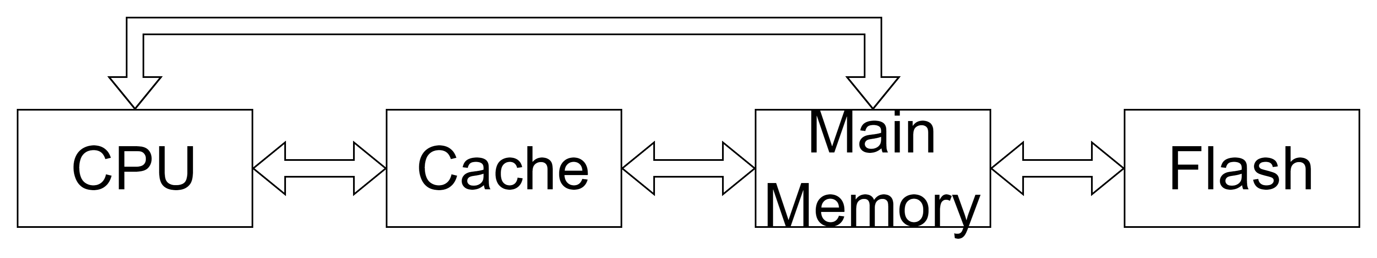
Computer Organization
SDD
Cache
MainMem
SDD(Flash)

Slide 20
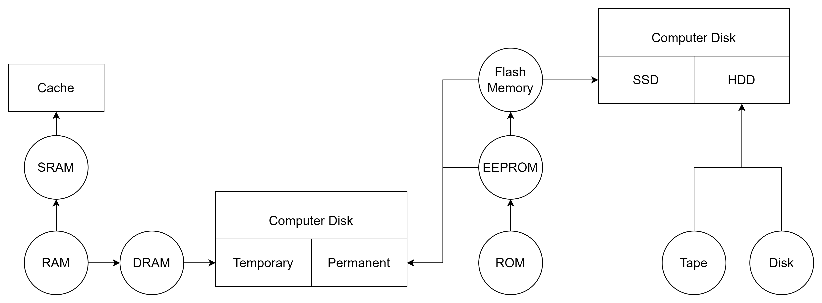
Computer Organization
Main Memory

